Slide 1

Huanyue Chen, Shoukang Hong, Wanjun Yu

Slide 2
Screen list
There are in total xx screens for our app including:
Home screen
Recycler grid for each event.
Event screen
Recycler row for each participant.
Post screen
Follower/Following manager screen
Recycler row for each follower/following user
Chat list manager screen
Recycler row for each chat
Chat room screen
Recycler row for each receiver and sender message

Slide 3
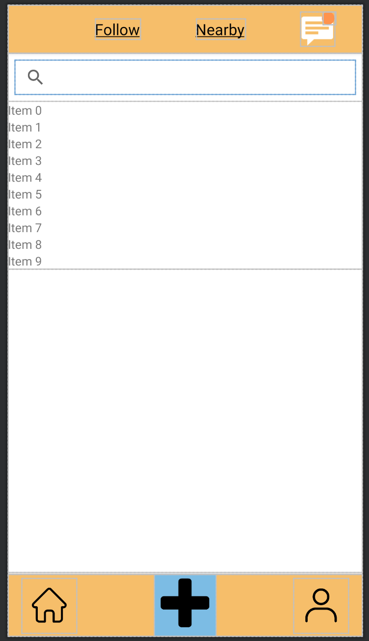
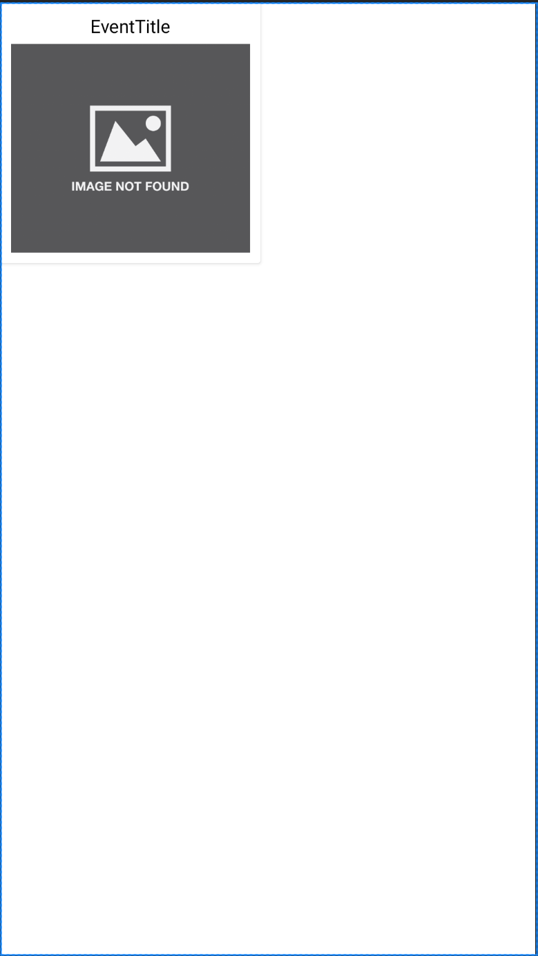
Home Screen
This is the home screen, which contains 2 column of events and essential buttons to navigate to different pages.
We will build the participant list using RecyclerView. Each grid of the RecyclerView is rendered from the Layout home_events_recycler_row.xml.
Recycler View
One row in the Recycler View

Slide 4
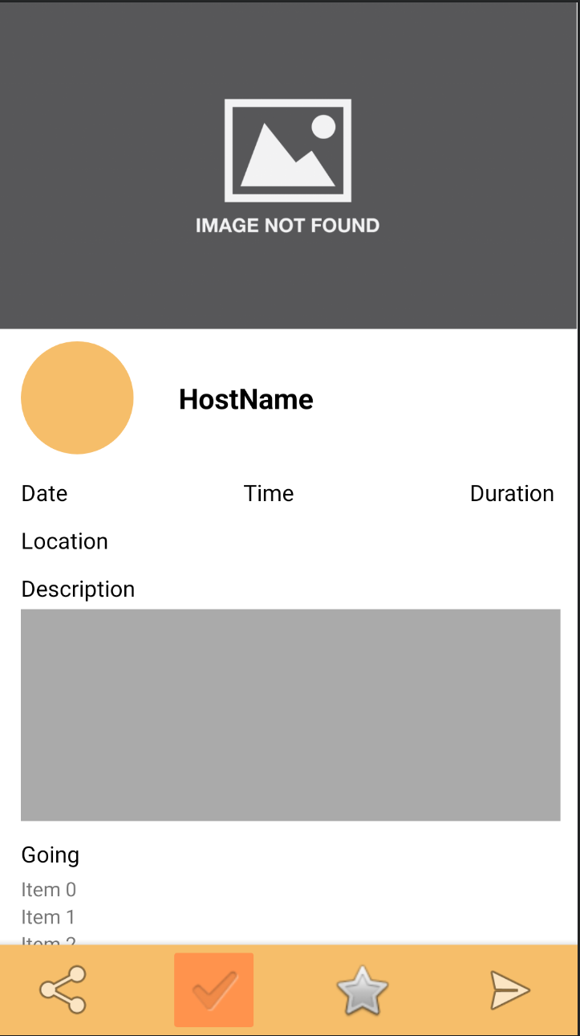
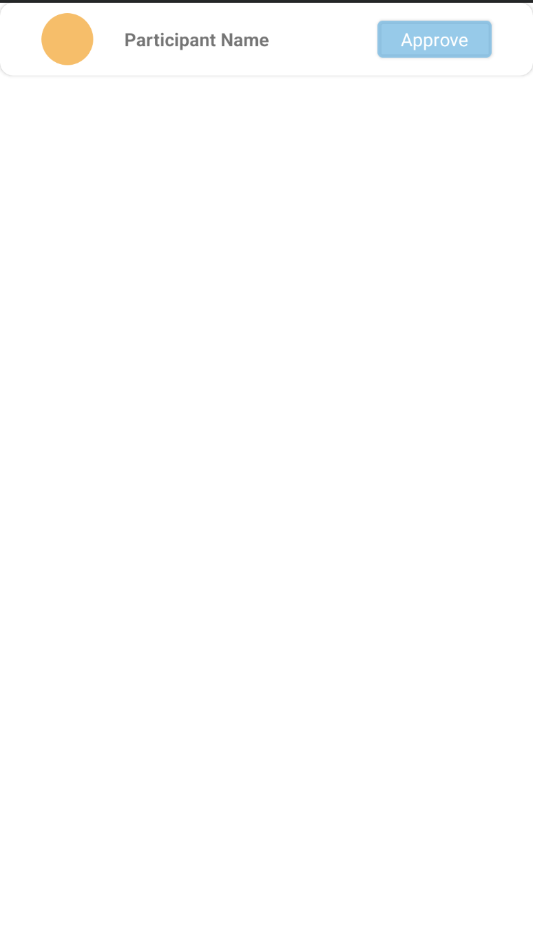
Event Screen
This is the event screen, which includes information of an event, a list of participants, and buttons to interact with the event.
We will build the participant list using RecyclerView. Each row of the RecyclerView is rendered from the Layout participant_recycler_row.xml.
One row in the Recycler View
Recycler View

Slide 5
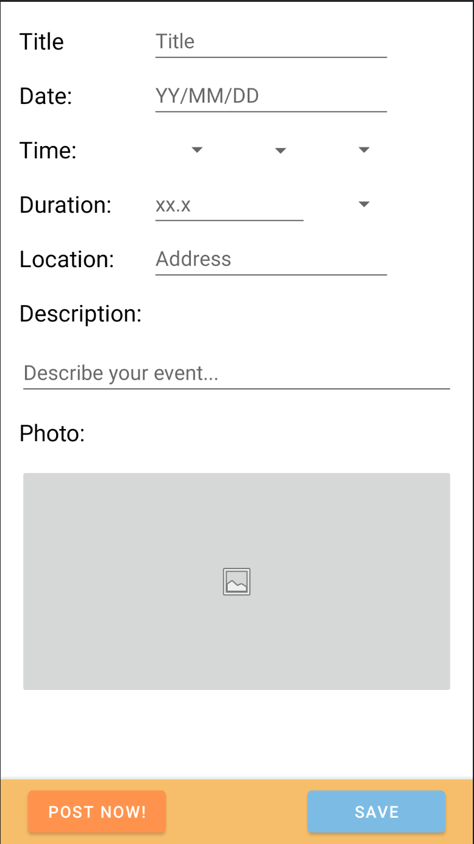
Post Screen
This is the post screen, which contains input areas for users to setup and post event info.

Slide 6
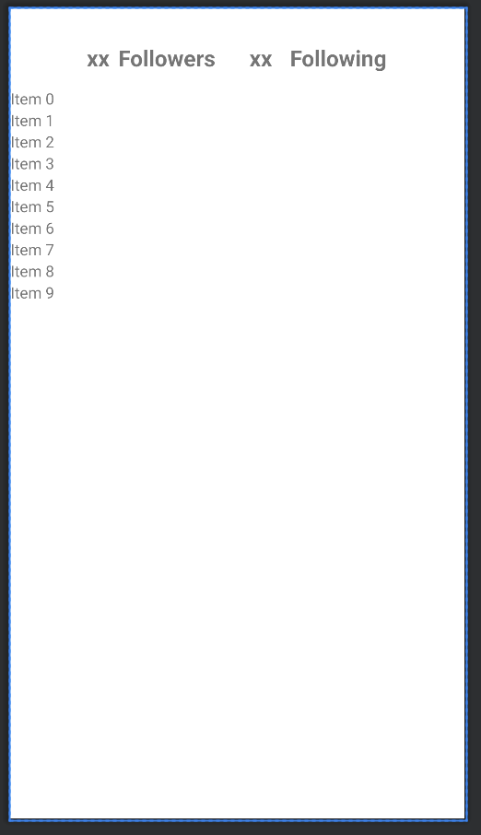
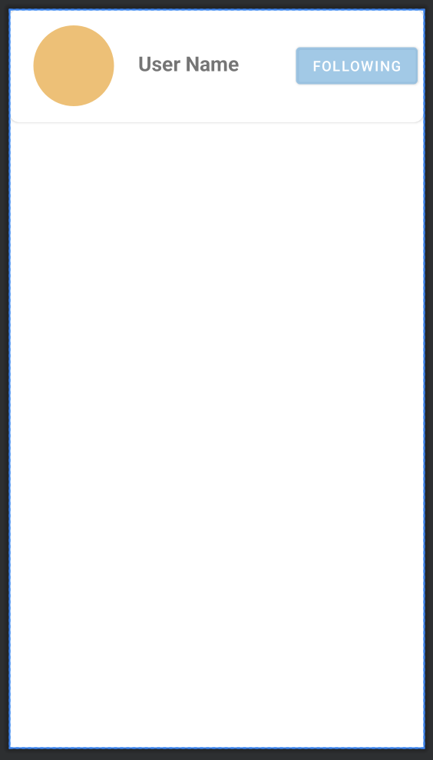
Follower Manager Screen
This is the Follower/Following manager screen, which contains a list of followers/following users.
We will build the list using RecyclerView. Each row of the RecyclerView is rendered from the Layout followers_recycler_row.xml.
Recycler View
One row in the Recycler View

Slide 7
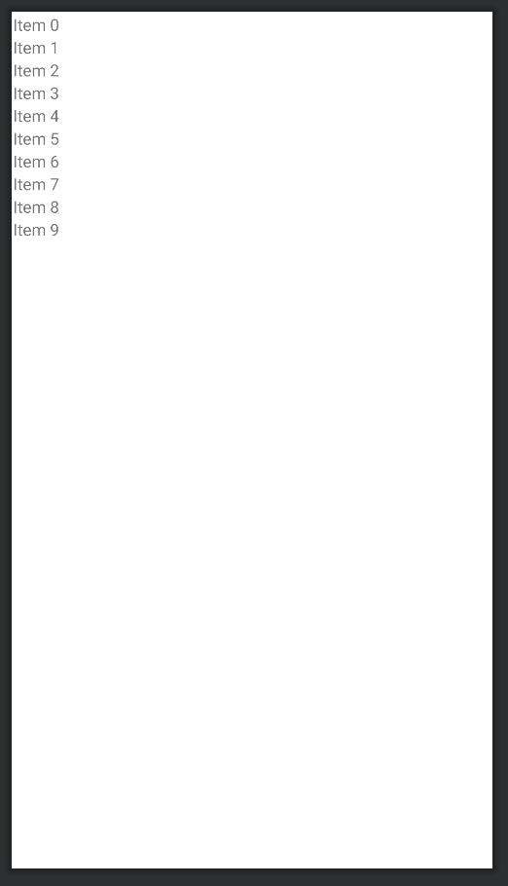
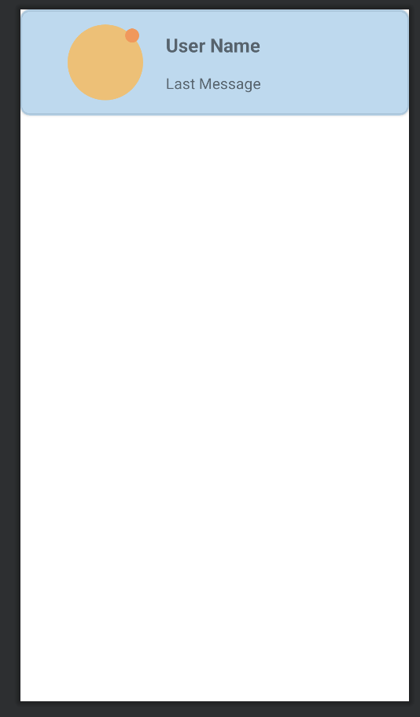
Chat list Manager Screen
This is the chat list manager screen, which contains a list of chat rooms.
We will build the list using RecyclerView. Each row of the RecyclerView is rendered from the Layout chatmanager_recycler_row.xml
The recycler row will include the user profile photo, user name and latest message. When there is an unread message, there will be an orange dot on the top right of the user profile photo
Recycler View
One row in the Recycler View

Slide 8
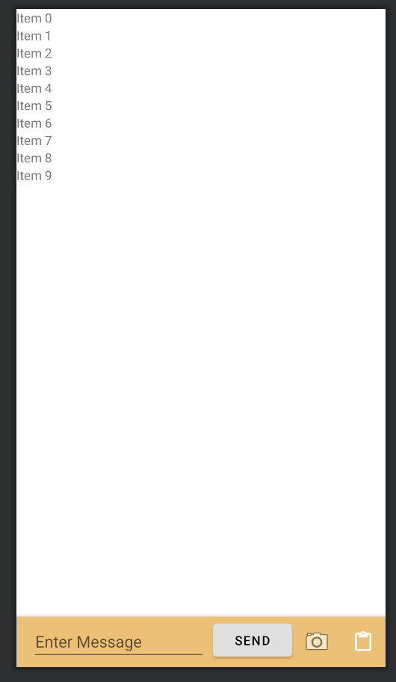
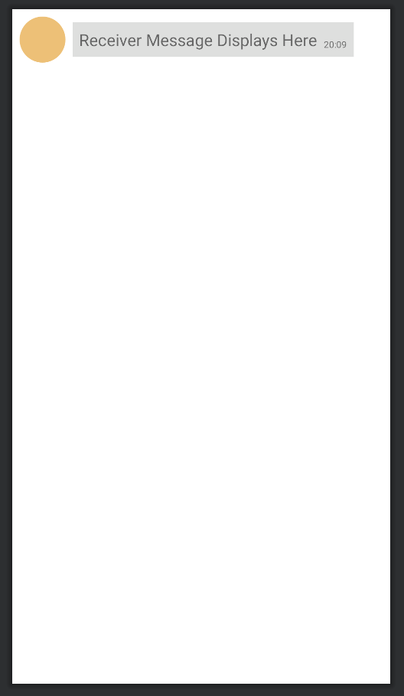
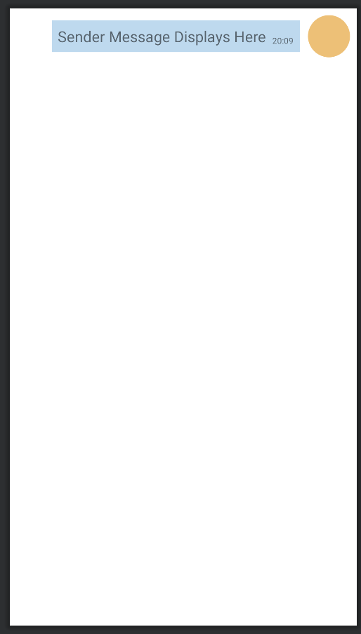
Chat Room Screen
This is the chat room screen, which contains a list of messages in the room.
We will build the list using RecyclerView. The receiver message will be rendered by Layout receiverchat.xml, while the sender message will be rendered with Layout senderchat.xml
Recycler View
One row in the Recycler View – Receiver Message
One row in the Recycler View – Sender Message

